Slide 1
Choose Your Own Story:
The Cold War

Slide 2
The Scenario:
It is 1960, and you have just been elected President of the United States. The United States is deep in the middle of a war of ideologies with the Soviet Union. The Soviet Union, or USSR, is a communist nation. Communist ideas are the polar opposite of the democratic ideas of the United States. The Cold War has been heating up. The Soviets have obtained nuclear weapons and have been helping communist leaders in other countries overthrow their democratic governments. You won your election by vowing to deal with the Soviets and establish US dominance of the Cold War. A few months into your administration the USSR just elected a new President, Vladimir Yeltsin. This new president does not appear to be a hard-line communist like his predecessor.
Now that an new Soviet president has been elected, will you use diplomacy or more hardline tactics to eliminate the communist threat?
Click Here To See Your Options

Slide 3
Your Choices:
OPTION #2: You can reach out to President Yeltsin and see if the two of you can work through the problems and ideology that has almost led to war several times. The problem with taking this diplomatic approach is it makes you look weak to your citizens and to the USSR. If diplomacy is rejected, it will look like you were scared of the new Soviet Premier.
OR
OPTION #3: You can use the election of this new president to take a stand against communism and the evil it does. This will no doubt gain you popularity in the US and might help you get re-elected in four years. The problem is that it does not solve the dilemma of the Cold War, it only makes it worse. But if you want to ever try to negotiate with the Soviets it is best to do if from a position of strength.

Slide 4
The Results of Option #2:
You have decided to open a dialogue with President Yeltsin. Because of the hatred between the United States and the Soviet Union, you also decided to keep your attempt at diplomacy secret from the public. The idea of privacy does not last very long. Some hardliner inside your staff leaked your attempt at diplomacy to the media and they jumped on it. Newspapers, TV news and radio broadcast are calling you a weak president, socialist, communist and every other bad name in the book. To make matters worse, President Yeltsin has used this leak as leverage and he is calling you weak and a bad leader. Things are as bad as they could possible get.
Click Here To Determine Your Next Move

Slide 5
Your Choices:
Option#4: You can try to explain why diplomacy is the best option for the future of the United States. This will be a hard sell, but looking at the long term scenario you think it is the best option.
OR
Option #5: You can deny that you were seriously looking at diplomacy as a tool in dealing with the Russians and make a hardline stand. The only way to deal with communism is to draw a line in the sand.

Slide 6
The Results of Option #3:
You are going to take a stand against the evil Soviet Union and their Communist ways. This is the strategy that got you elected and it worked pretty well then. As soon as President Yeltsin is sworn in, you unleash a rant about how you hope his election will bring about positive changes in the Soviet Union because the citizens of the Soviet Union have been oppressed for decades under the evil communist regimes. You words are taken very seriously by President Yeltsin. He decides to move some nuclear missiles to a base in Eastern Siberia. This puts nuclear missiles close enough to strike cities on the west coast of the United States.
Click Here To Determine Your Next Move

Slide 7
Your Choices:
Option #9: You can listen to your advisors and start top secret, high-altitude, flyovers. The U2 planes can take pictures of bases and keep you informed about Soviet military movements. The information you get from fly overs will be reliable but dangerous to get.
OR
Option #8: You can issue a strict warning and demand the Russians remove the missiles. You can use this act of Russian against them and try to form a coalition of nations on your side to put pressure on the Russians.

Slide 8
The Results of Option #4:
You have decided to stand behind diplomacy as your main strategy for dealing with the Soviet Union. Your poll numbers have dropped dramatically over the last few months. The media has been reminding everyone that you have one of the lowest approval ratings for a president in modern history. Then, after a few months go by people are starting to see your point about diplomacy. President Yeltsin has also recently been quoted as saying how effectively diplomacy can be in resolving problems. Your approval rating starts to raise, then a new situation. Communist rebels in Korea are trying to over throw the democratic government and are being funded and supplied by the Russians.
Click Here To Determine Your Next Move

Slide 9
Your Choices:
Option#7: You have shown the world that you are willing to work with other countries, but the Soviets are unwilling to cooperate. Now you must show your strength! You want to aid the Korean government so you call a press conference and tell the world you are moving missiles to the Air Force base in the Philippines and are aiming them at Korea to aid the democratic government.
OR
Option #6: You can decide to hold the line that diplomacy works best. US citizens are starting to come around and this situation is no different than when you were first elected. Besides it is Korea, why would you worry about a rebellion in Korea?

Slide 10
The Results of Option #5:
You have decided to take a hard-line stand against communism. Your attempt at diplomacy made you look weak and now the voters in the US wish they would have elected the other candidate. You call a press conference and outline a plan to stop communism from spreading to other nations and help citizens who live in communist nations overthrow their governments if they wish. This hard-line stance gets you rave reviews from US citizens, but it makes President Yeltsin angry. Yeltsin decides he is going to put nuclear weapons in Siberia, the eastern most region of Russia. These nuclear missiles are easily in range of the west coast of North America. Your cabinet is pushing you to put missiles in the Philippines.
Click Here To Determine Your Next Move

Slide 11
Your Choices:
Option #7: You can put the missiles on your Air Force base in the Philippines. This would give you a way to retaliate if the Soviets tried anything. It also allows you to show you are not messing around.
OR
Option #8: You realize you tried the hard-line stance and it back fired. You decide that now is the time to resume diplomacy. Maybe the best action to take would be to form a coalition of other nations against the Soviets or open some back channel communication with President Yeltsin.

Slide 12
The Results of Option #6:
You have decided to hold to your diplomacy strategy. You know that if you put missiles in the Philippines it would escalate the situation. In theory, this was a great idea. The problem is now everyone hates you. Your presidential approval rating is the lowest ever. Congress is trying to find a way to impeach you and the media is calling you every name in the book. Everyone thinks you are weak and gutless. One good thing that has happened is a possible chance for backdoor diplomacy. It seems that President Yeltsin might be sending a message through his agents to see how war can be avoided. This sounds promising but it might not move quickly enough with the pressure voters and congress are putting on you.
Click Here To Determine Your Next Move

Slide 13
Your Choices:
Option #7: You can opt for a show of strength and put missiles on the Air Force base in the Philippines. This might get voters off your back and buy you a little time to try more diplomacy.
OR
Option #12: You can keep talking about how diplomacy is your best option and hope that it wins over voters. While you are doing this you can pursue the back door diplomacy option that might be starting to open up.

Slide 14
The Results of Option #7:
You are taking a stand and putting missiles on your Air Force base in the Philippines. You made sure the world saw you put the missiles on the base and why you were doing it. Other countries are lining up on your side and even a few are siding with the Soviets. Things are starting to get tense. Your advisors are telling you that you need to take things to the next level and find out what the Soviets are doing. They are advising that you start fly overs with your high-altitude planes called U2’s or activating your informants in the Russian government.
Click Here To Determine Your Next Move

Slide 15
Your Choices:
Option #9: You can listen to your advisors and start top secret, high-altitude, flyovers. The U2 planes can take pictures of bases and keep you informed about Soviet military movements. The information you get from fly overs will be reliable, but dangerous to get.
OR
Option #10: You can activate your informants in the Russian government. You can use the information they give you to make decisions. The information might not be as reliable, but it is safer than fly overs.

Slide 16
Results for Option #8:
It did not take you very long to form a coalition of nations to put pressure on the Soviet Union. The United Kingdom, France, Italy, Greece, and Austria have aligned themselves with you. The Soviet Union scrambles to find countries to take their side, but they cannot find any. Even China, another large Communist nation, has decided to sit this one out. Your hopes have materialized because word has it that Yeltsin would like to work out a deal because he knows he cannot compete with your coalition. This information is coming through back channels because there is no way Yeltsin can make those statements publicly, as the Soviet hardliners would eat him alive. The only problem is that the information might not be reliable.
Click Here To Determine Your Next Move

Slide 17
Your Choices:
Option #7: You can make Yeltsin sweat while you have the upper hand. You can ignore his request for a deal and put your own missiles on your Air Force bases in the Philippines. No need to get the approval of the other nations in your coalition.
OR
Option #16: You can pursue the deal with President Yeltsin. This was the ultimate goal all along but it won’t make you popular with the anti-communist voters.

Slide 18
Results for Option #9:
You have decided to start flyovers. The information and pictures that the planes are able to get you have proven extremely valuable. You are able to see where the Soviets are moving their troops and machinery. You are also able to see what the Koreans are doing and also monitor the response to your missiles in the Philippines. After a few great days of flights your worst fears have happened. A U2 flying over Soviet airspace is shot down and the pilot was killed. You bombed the rebels in Korea in retaliation but that is not enough. The American public is demanding stronger action from their president.
Click Here To Determine Your Next Move

Slide 19
Your Choices:
Option #11: You can send ground troops in through bases that you have in Turkey and start bombing runs on Soviet bases to neutralize any counter attack. You have up-to-date information with your U2 photos and striking first could cripple the USSR.
OR
Option #15: You can put additional missiles on your bases in Turkey. This strengthens your position against the Soviets and allows you to retaliate indirectly for your U2 being shot down.

Slide 20
Results for Option #10:
You have decided to activate your Russian informants. It does not take very long to learn lots of valuable information. First, you learn that Yeltsin is the hardliner you thought he was but Vice President Karloff is much more open to diplomacy. You learn that President Yeltsin has plans to invade other nations such as Poland and Czechoslovakia and establish satellite countries he can exploit for workers and natural resources. You informants also relay the downfalls of communism. Grocery stores are empty because workers are refusing to keep up with demand and people are thrown in prison or killed for the smallest things. The most important information you learn is that President Yeltsin’s security detail is not very trust worth. Your informants have learned of a way to poison him and make it look like an accident. With Yeltsin out of the way, there is a chance President Karloff would take over and be much more reasonable.
Click Here To Determine Your Next Move

Slide 21
Your Choices:
Option #19: With this new information your advisors are suggesting you go to DEFCON 3. This lets your military know you are serious and they will begin preparations for war.
OR
Option #13: You can trust your informants and use them to assassinate President Yeltsin. They assure you they can make it look like a heart attack.

Slide 22
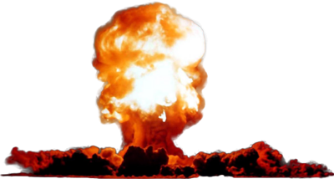
Results for Option #11:
DEFCON 3 was a bad idea. The other countries that were on your side have now abandoned you because they do not want war. They know that if two nations are going to go to war with nuclear weapons they should get out of the way. Your shift to DEFCON 3 has motivated the already war-crazy Soviets and they mobilize their fleet of nuclear subs. There is no way you can let those subs close to US waterways so you send out your destroyers. Before you know it, one of your destroyers is sunk by a Soviet sub. Now you are at war. Three years later, the US has 3 million casualties in the war but you have not been able to get to the capitol city of Moscow. The Soviets are faring much worse. They have 15 million deaths and are sending people to fight with rocks and shovels. Much of their nuclear arsenal has been knocked out by your strategic air strikes but satellites warn you they are preparing to launch them. You cannot wait, so you launch 3 nuclear weapons and destroy Moscow, St Petersburg and Kiev. As soon as you launch your nuclear missiles the Soviets launch theirs. Two bombs from Siberia destroy the cities of Los Angeles and San Francisco. Two more, launched from a sub in the Arctic destroy New York City and Washington D.C. Six months later, the war ends because the Soviet Union runs out of resources. You have won the Cold War, lost your next election, and destroyed the American way of life.
Boom!
The End

Slide 23
Results for Option #11:
You have decided to bomb the Soviet bases and send in troops. You work with Air Force commanders to develop the best plan for bombing the bases. After a few hours, you have an outline in place that will allow you to destroy important Russian defenses and clear a path for your troops to get to Moscow. You start the bombing and everything goes great…for a few hours. Then, the worst case scenario happens. You were unaware of some Soviet nuclear submarines off of the west coast of the US. After you destroyed their bases and started the invasion, the Russian submarines launch nuclear weapons and destroy every major city on the west coast. You retaliate and launch your own nuclear weapons destroying Moscow, St Petersburg and several other heavily populated Russian cities. The Russians attack again, so again you retaliate. Soon the Soviet Union is destroyed, but so is the United States. All major U.S. cities have been demolished and millions of people have died. Radiation from the blasts still threaten surviving citizens. The Cold War is over but these two superpowers are destroyed forever.
THE END

Slide 24
Results for Option #12:
As leader of the most powerful nation on earth, you sure look like a sissy and the American people are angry. However, it takes real strength to stick with diplomacy. As you talk everyday about how the United States and the Soviet Union should learn how to solve problems and work through differences without war people are starting to agree. Especially when you talk about how war would eventually lead to nuclear war and how tens (or hundred) of millions would end up dead. President Yeltsin in Russia has now flipped back to his hardline stance in the news, but through your backdoor talks through representatives you hear that he is saying these things so he does not get overthrown in a coup (an overthrow by a military or political group). You are not sure if you can believe this, what you do know is that the Vice President Karloff talks more about diplomacy than Yeltsin and if he was in charge it might help speed up the diplomatic process.
Click Here To Determine Your Next Move

Slide 25
Your Choices:
Option #14: You can keep listening to Yeltsin’s hard line stand against the United States and ignore his assistance in the overthrow the Korean government. You can also ignore demands for your resignation and stay with your attempts at back channel negotiations.
OR
Option #13: The CIA has presented you with an option. Through their spies and informants they have found a way to poison President Yeltsin where it will look like a heart attack. This will allow his Vice President to gain power and you think he will be much more reasonable.

Slide 26
Results for Option #13:
You have successfully killed your first government leader. President Yeltsin is dead and after a messy transition, President Karloff has been elevated to President. Your agents inside the Soviet government are telling you now the behind the scenes dialogue of peace were coming from Karloff when he was Vice President, not from Yeltsin. It looks like you made a good move for peace. Unfortunately, the first thing Karloff does when he becomes President is arm his missiles in Siberia. When those missiles became armed you had no choice but to put missiles in the Philippines. To keep track of what is going on in the Soviet government and military bases your advisors are telling you to start flying high-altitude surveillance mission with your U2 planes.
Click Here To Determine Your Next Move

Slide 27
Your Choices
Option#9: You can start high-altitude surveillance missions with U2 planes to gather all the information. Your U2 planes fly so high in the sky that no one will even know they are there and they can give you much need, up to date, information.
OR
Option #16: You can arm your missiles in the Philippines to show the American public you are staying firm against Communism but start a new dialogue through your agents with the new president.

Slide 28
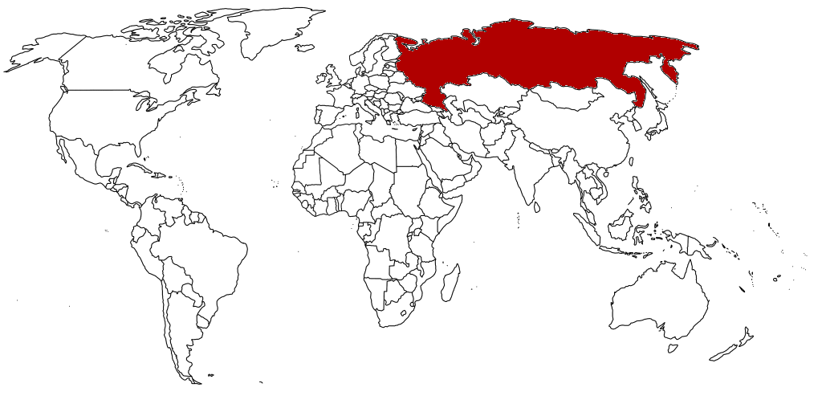
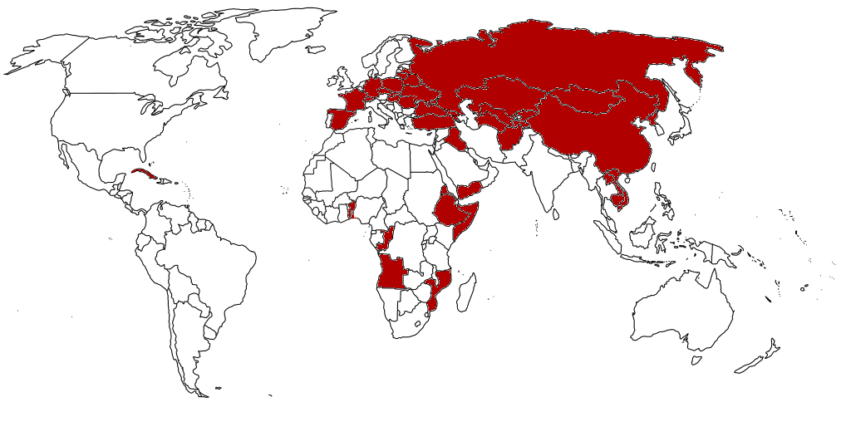

Slide 29
Results for Option #14:
Amid all the talk about how you are the worst president in history, how you are soft on communism and how you are not protecting US allies you have stayed the diplomatic course. You feel so strongly that this is the correct approach that you have ignored everything Yeltsin has done. He won an election with anti-US rhetoric, put weapons where they could hit US cities, helped overthrow a friendly government and continue talking bad about capitalism and the US way of life. President Yeltsin is a better president than you. While you were reaching out trying to make a treaty he secretly put nuclear submarines off the east and west coast of the United States. Then he started to attack countries geographically close to Russia. Poland, Germany, France and Spain all fall to the Soviet military. You try to come to their assistance but then Yeltsin reveals the nuclear submarines with missiles aimed at US cities. If you attack, he will kill millions US citizens. You have no choice but to stay out of it and watch European countries fall and convert to communism. Congress tries to impeach you for lack of leadership but you decide to resign instead. The US loses the Cold War and you are considered the worst president in US history.
The End

Slide 30
Results for Option #15:
You have put missiles in Turkey. You actions have made you popular in the United States but you are hoping the Soviet Union will see you are serious and back off. It has worked. The Soviet Union’s President has issued an apology for shooting down the U2. This is not a public apology, because he cannot be made to look weak in front of his citizens or his military commanders. He explained that there are some military commanders who want to go to war with the US and they were the ones who shot down the U2 without his permission. This explains his hard-line stand during your earlier attempt at diplomacy. You, and a few of your advisors, think that his explanation is legit and a few others think he is playing you for a fool and just telling you want you want to hear.
Click Here To Determine Your Next Move

Slide 31
Your Choices:
Option #16: You can take him up on his offer for diplomacy. Some of your advisors (your cabinet) might not agree, but you are the president. You can do what you want.
OR
Option #19: You ignore his offer. You know if you are wrong and the diplomacy offer is not legit you will look like a fool. Some of your cabinet is recommending that you move your military to DEFCON 3. This tells them to get ready for war.

Slide 32
Results for Option #16:
You are pursuing a deal with the Soviet President and things are looking good. Against the opinion of all the hard-core anti-communist in the US, you have convinced the Soviets to remove their missiles from Siberia. As you are working through your difference, two things happen that might define your presidency. First, it comes to your attention that even as you are talking with the Soviet’s, they are still funding a group of Korean rebels trying to overthrow the democratic government in Korea and replace it with a communist regime. This tells you that even though the Russians are working with you they cannot be completely trusted. Second, one morning you awake to hear from your advisors that a nuclear power plant has exploded in the Russian city of Chernobyl and the Soviets are in desperate need of aid.
Click Here To Determine Your Next Move

Slide 33
Your Choices:
Option #17: You can take advantage of the nuclear explosion and aid the Korean government in their fight against communism. As well as diplomacy was working, you cannot let another country fall to communism. This distraction provides the perfect opportunity.
OR
Option #18: You can take this opportunity to show the Soviets that you are serious about making this relationship work and send help to Chernobyl, site of the nuclear explosion. This olive branch is a risky move; if things do not fall in place fast enough it will probably cost you an election.

Slide 34
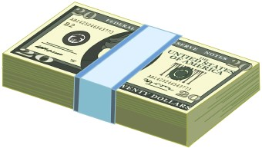
Debt!
The End

Slide 35
Results for Option #17:
You have decided to seize the opportunity and send aid to the Korean government as they try to fight the communist insurgency. This turned out to be a good move and a bad move. Because of the aid you sent Korea, they were able to defend their democracy and stay that way today. Bad news is that by doing this you shattered the trust you were developing with the USSR. The USSR broke off the diplomacy and now they have helped rebels Vietnam, Cuba, and Cambodia overthrow their governments and establish communist regimes. You sent weapons and money to help those countries but it was to no avail. The voters are also upset with you. You spent trillions helping Korea and other countries and it was money you did not have. You have doubled the national deficit, inflamed the Cold War, lost several countries to communism and now you have lost your next election as President. History will remember you as a one-term president who made the world a worse place.
The End

Slide 36
Results for Option #18:
Peace!
You have decided that you will help the Soviets after they experience a nuclear explosion in the city of Chernobyl. There are two reasons why you are helping them. First, you know the Soviets would not help you, so you are showing them what America is all about. You send over your disaster team along with several doctors and a few scientists. The Soviets play tough at first, but they soon soften and accept your help. This olive branch is the turning point in the Cold War. Within a few years, the Soviets agree to not aid any government overthrows and despite their differences the two great superpowers in the world work to make the world a better place. Your place in history is secure. You are seen as one of the greatest president and have your own memorial built in Washington D.C.
The End

Slide 37
Results for Option #18:
You have decided that you will help the Soviets after they experience a nuclear explosion in the city of Chernobyl. There are two reasons why you are helping them. First, you know the Soviets would not help you, so you are showing them what America is all about. You send over your disaster team along with several doctors and a few scientists. The Soviets play tough at first, but they soon soften and accept your help. This olive branch is the turning point in the Cold War. Within a few years, the Soviets agree to not aid any government overthrows and despite their differences the two great superpowers in the world work to make the world a better place. Your place in history is secure. You are seen as one of the greatest president and have your own memorial built in Washington D.C.
The End

Slide 38
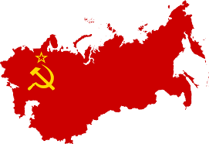
Draw!

Slide 39
Results for Option #19:
DEFCON 3 was a bad idea. The other countries that were on your side have now abandoned you because they do not want war. They know that if two nations are going to go to war with nuclear weapons they should get out of the way. Your shift to DEFCON 3 has motivated the already war-crazy Soviets and they mobilize their fleet of nuclear subs. There is no way you can let those subs close to US waterways so you send out your destroyers. Before you know it, one of your destroyers is sunk by a Soviet sub. Now you are at war. Three years later, the US has 3 million casualties in the war but you have not been able to get to the capitol city of Moscow. The Soviets are faring much worse. They have 15 million deaths and are sending people to fight with rocks and shovels. Much of their nuclear arsenal has been knocked out by your strategic air strikes but satellites warn you they are preparing to launch them. You cannot wait, so you launch 3 nuclear weapons and destroy Moscow, St Petersburg and Kiev. As soon as you launch your nuclear missiles the Soviets launch theirs. Two bombs from Siberia destroy the cities of Los Angeles and San Francisco. Two more, launched from a sub in the Arctic destroy New York City and Washington D.C. Six months later, the war ends because the Soviet Union runs out of resources. You may have won the Cold War, but it has come at a heavy cost. You lost your next election and destroyed the American way of life.
The End

