Slide 1
Unit #2:
European Colonization

Slide 2
European Colonization
European Colonization
Once the New World is discovered, the Big 4 four European countries begin competing for control of North America and the world….
Spain
England
France
Portugal
This power struggle ultimately leads to several wars.

Slide 3
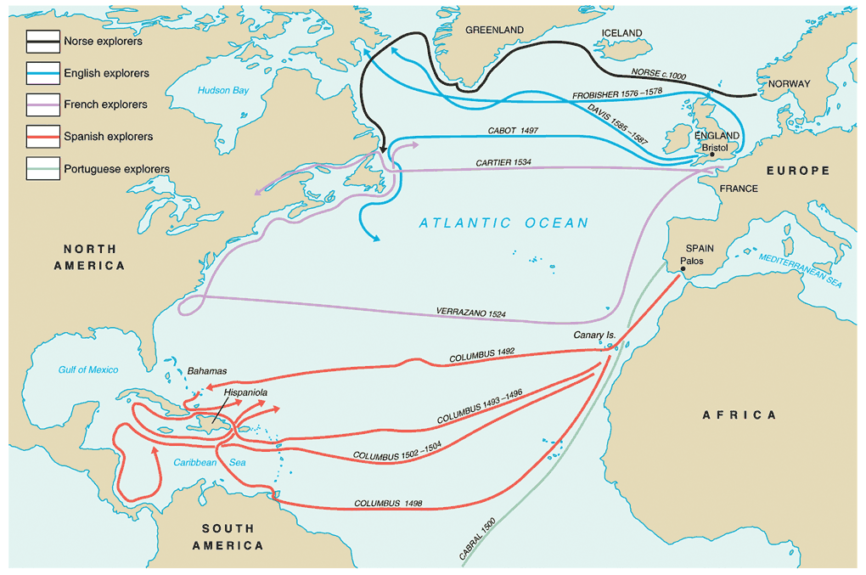
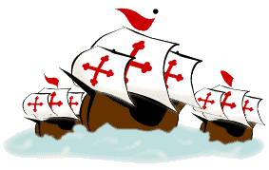

Slide 4
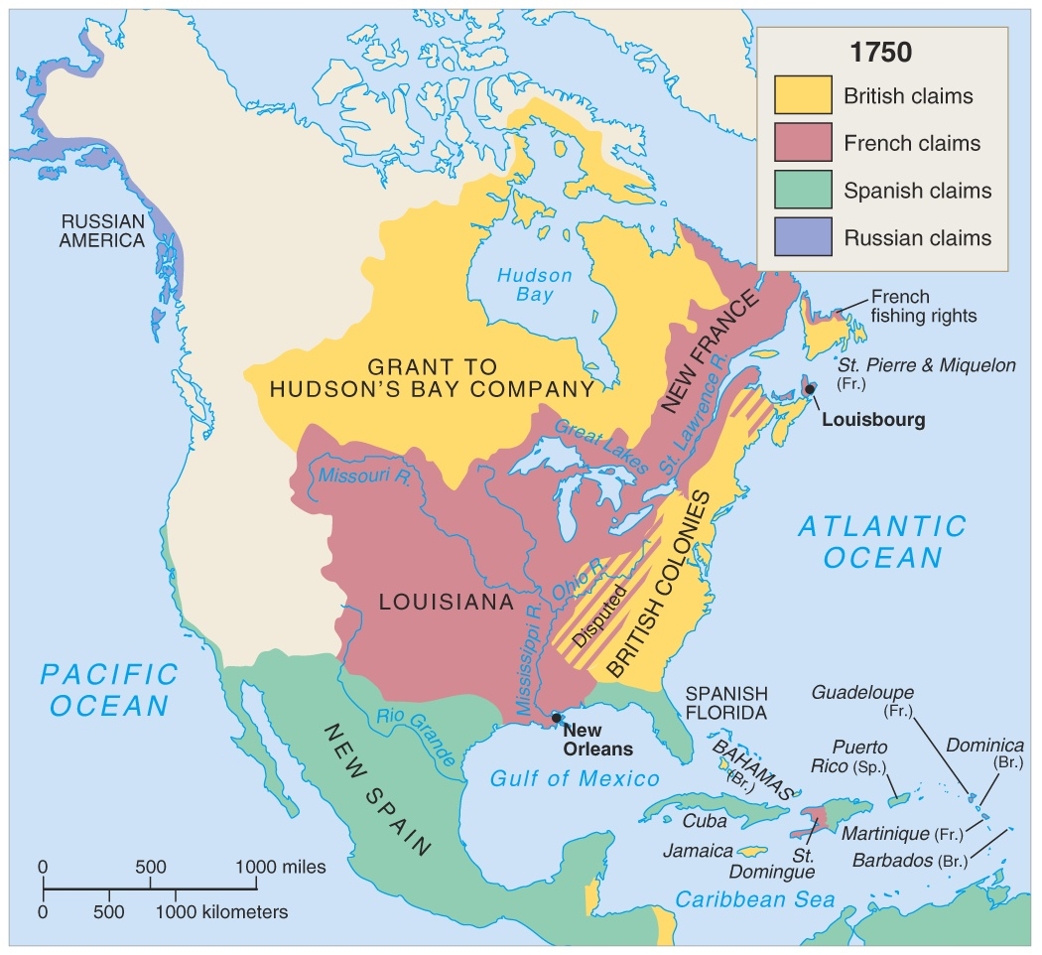

Slide 5
The
Spanish
Spanish first to pursue colonization
Start in Caribbean, then Central and South America—most important was conquest of Aztecs by Cortez (1521) and Incas by Pizzaro (1531)
First permanent colonies in what will become United States are founded by Spain
St. Augustine (Florida) is founded (1565) to protect Spanish treasure fleets

Slide 6
Explorers Sailing For Spain
Columbus - Italian sailing for Spain - Landed in the “West Indies” - 1492
Magellan - Portuguese sailing for Spain - 1st to circumnavigate the world - 1522

Slide 7
Explorers Sailing From Hispaniola
De Leon - colonist of Hispaniola - Established colony at Puerto Rico - Sailed north looking for Fountain of Youth - Discovered Florida - 1508
Balboa - colonist of Hispaniola - Established settlement in Panama - 1st European to see Pacific Ocean - 1513
de Coronado - Spain - Explored north from Mexico; up Colorado River; saw Grand Canyon -1540
de Soto - Spain - Explored Florida into Carolina’s and west to the Mississippi River - 1541

Slide 8
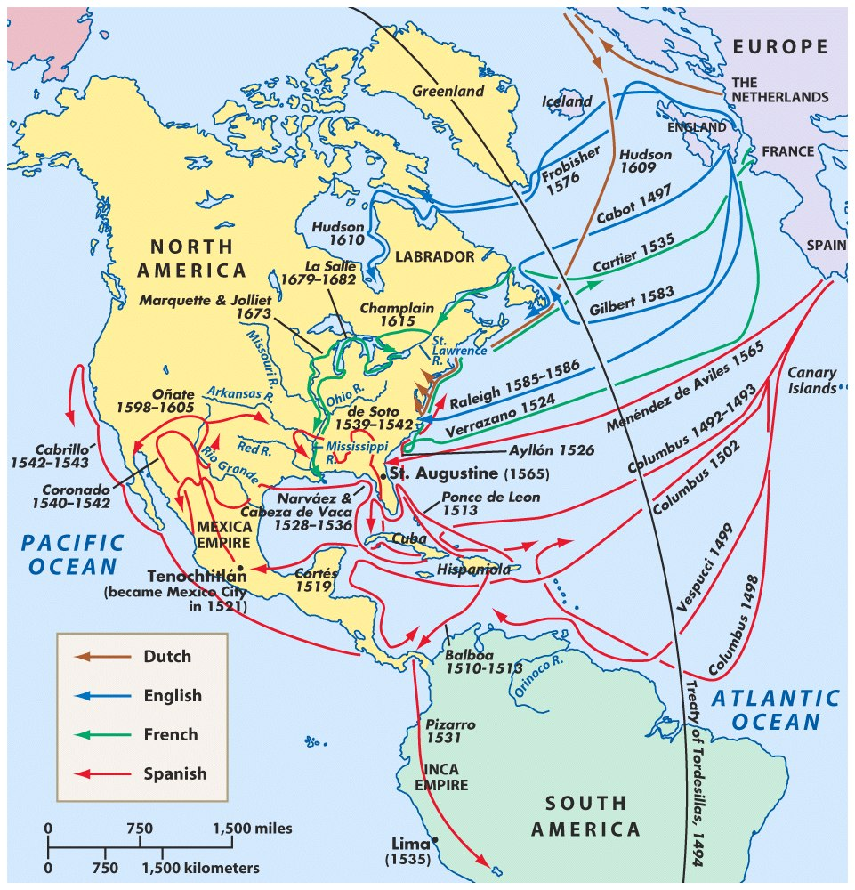
Spanish Exploration
Columbus
Balboa
Cortes
Pizarro
De Leon
De Soto
Coronado
Vespucci

Slide 9
SPANISH OBJECTIVES IN THE NEW WORLD
WEALTH
POWER & GLORY
EXPAND BOUNDARIES
SPREAD RELIGION
COLONIES LOCATED IN SOUTH AMERICA, CENTRAL
AMERICA & SOUTHERN NORTH AMERICA

Slide 10
Spanish soldiers who came to the New World to help conquer and settle the Americas for Spain.
Some of their methods were harsh and brutal especially to the Native American population.

Slide 11
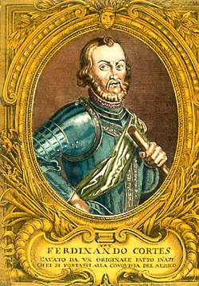
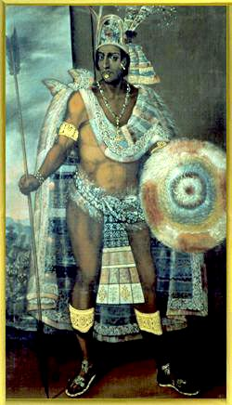
First Spanish Conquests: The Aztecs Cortes conquered Aztec Empire in 1519 and took control of modern day Mexico.
vs.
Hernando Cortés
Montezuma II

Slide 12
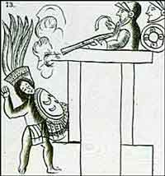
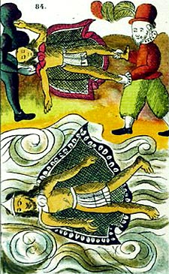
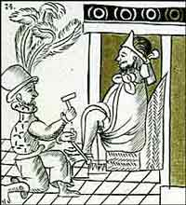
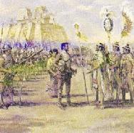
The Death of Montezuma II

Slide 13
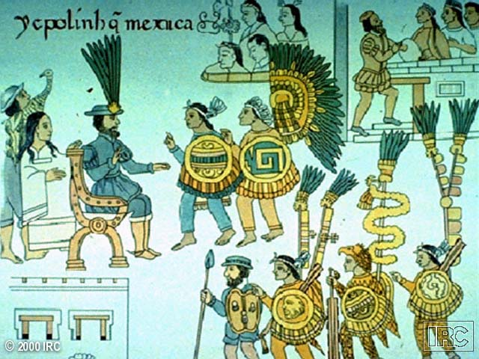
Mexico Surrenders to Cortés

Slide 14
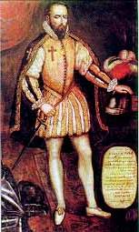
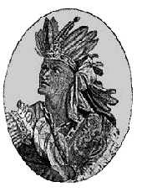
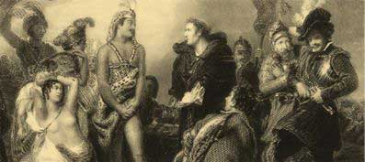
First Spanish Conquests: The Incas Pizarro conquered Incan Empire in modern day Peru in 1532
vs.
Francisco Pizarro
Atahualpa

Slide 15
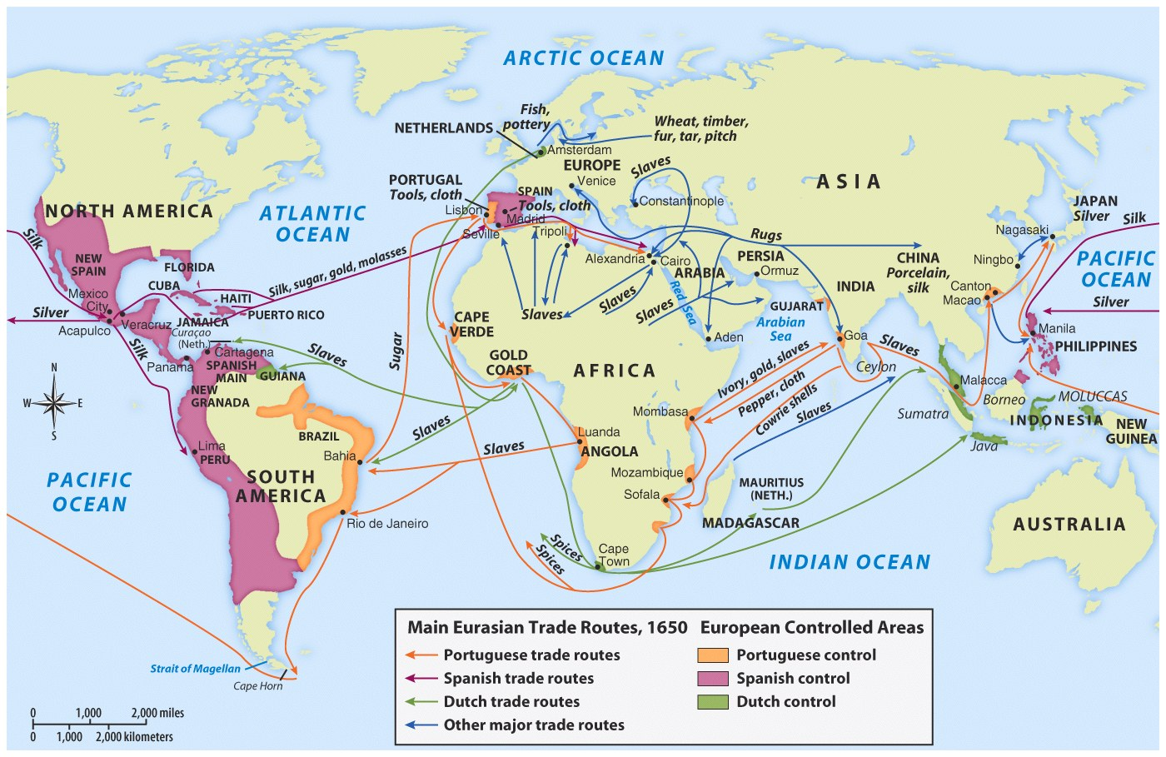

Slide 16
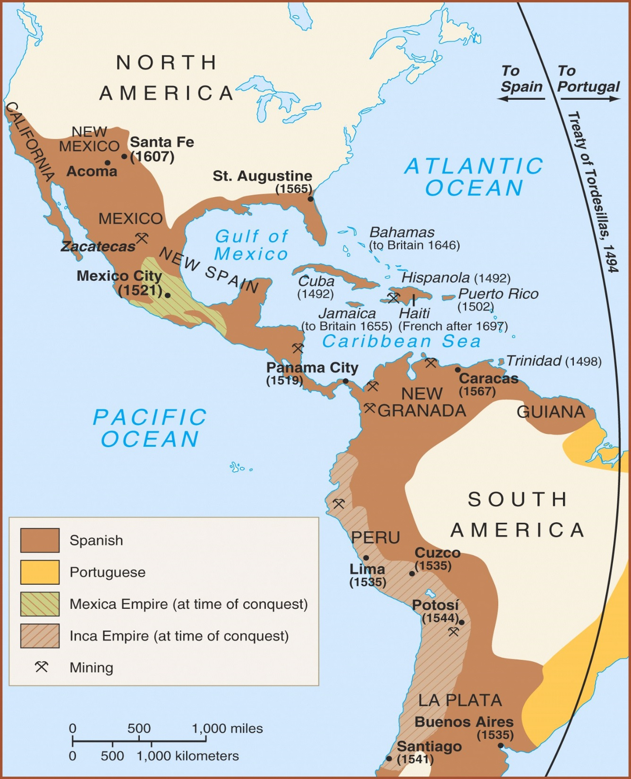
Spanish empire by the 1600’s consisted of the
part of North America
Central America
Caribbean Islands
Much of South America.

Slide 17
Cycle of Conquest & Colonization
Explorers
Conquistadores
Missionaries
European Colonial Empire
Permanent Settlers

Slide 18
The Colonial Class System
Peninsulares European (Spanish) Born
Creoles European Ancestry Born in the New World
Mestizos European and Indian mixture
Mulattos European and African mixture
Native Indians
African Slaves

Slide 19
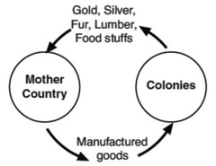
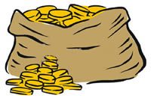
MERCANTILISM
The idea that a country can gain power by building up its wealth by trading with other countries (exporting and importing)
COLONIES EXIST TO BENEFIT THE MOTHER COUNTRY.
Need to build up treasury (silver and gold)

Slide 20
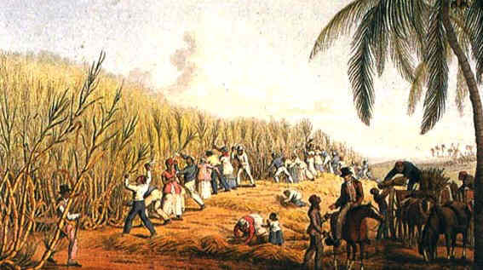
The Plantations
Colonists set up plantations. A plantation is a huge farm.
The plantations in New Spain grew sugarcane, tobacco, coffee, cocoa, cotton, and other crops that could be sold in Spain.
Relied heavily on slave labor supplied by the Native Americans and later imported Africans.

Slide 21
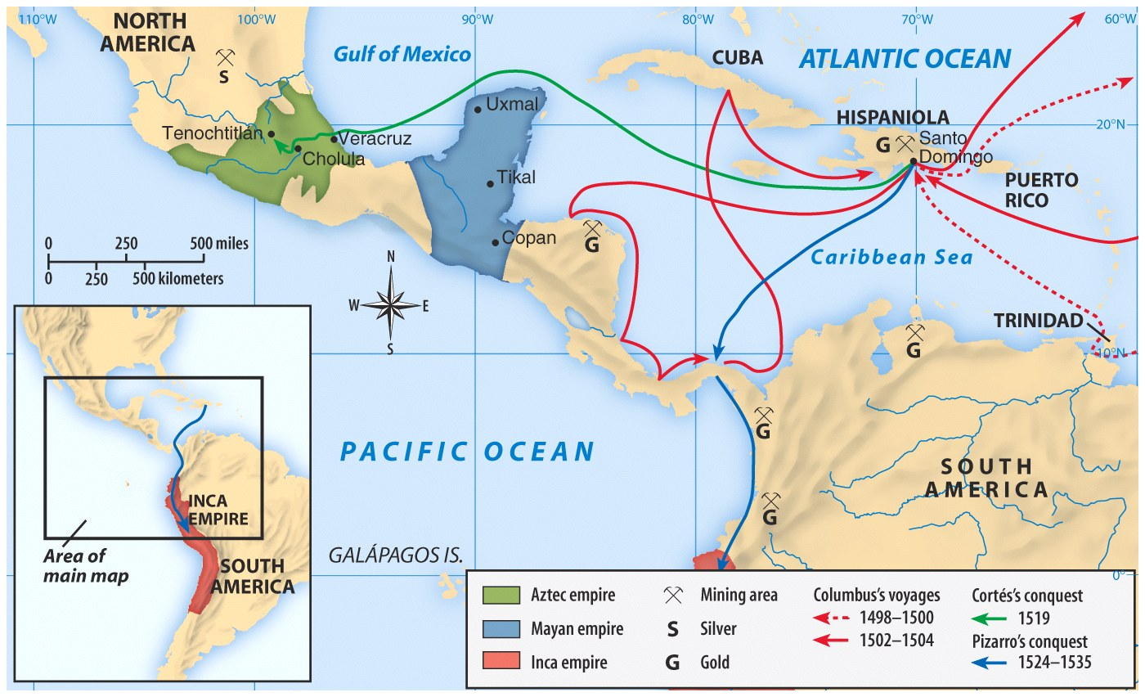
Gold and Silver Mines:
The wealth of Spain's new colonies in Latin America derives mainly from silver and gold mines
20% of all gold and silver went to the Spanish crown
Tons of silver found in Bolivia- More silver was mined over the next hundred years, than had existed in all of Europe up to that time
The natives were forced to world long, dangerous hours in the mines- many died
Treasure brought over on huge fleets of ships = attacks by British Privateers

Slide 22
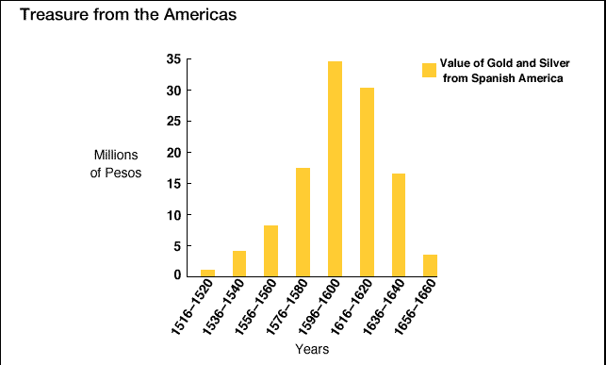
Treasures from the Americas!

Slide 23
ENCOMIENDA SYSTEM
1. Spanish practice of securing an adequate and cheap labor supply = FEUDALISM
“granted” to deserving subjects of the King
2. Conquistador controlled Indian populations
Required Indians to pay tribute from their lands
Indians often rendered personal services as well.
3. In return the conquistador was obligated to
protect his wards
instruct them in the Christian faith
defend their right to use the to live off the land
4. Encomienda system eventually decimated Indian population.
5. The King prevented the encomienda with the New Laws (1542) and the system gradually died out.

Slide 24
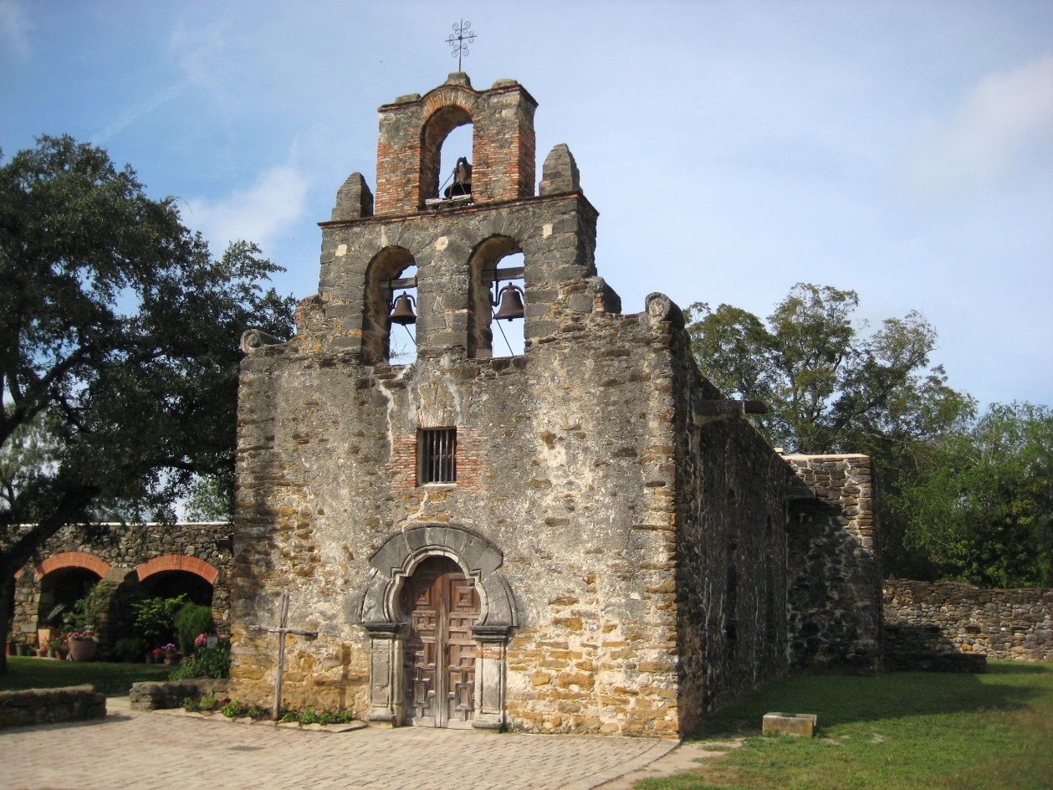
The Influence of the Catholic Church
Spain after 1492 was a Catholic country, since Spain had expelled the Jews and converted the Muslims living there. Spain was a fierce defender of the Catholic Church after the Protestant Reformation.
With every Spanish explorer were conquistadors and members of the Catholic Church to convert Native Americans- missionaries
The Spanish firmly believed they had the right to conquer and colonize the New World to bring Christianity to the Indians. In their minds, saving souls was worth destroying bodies, if need be. They used this argument to justify almost anything they did in the New World,
Spanish Mission

Slide 25
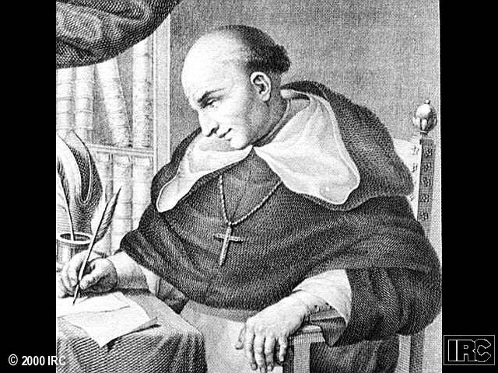
Father Bartolomé de Las Casas
Believed Native Americans had been treated harshly by the Spanish.
Indians could be educated and converted to Christianized.
Believed Indian culture was advanced as European but in different ways.
New Laws --> 1542

Slide 26
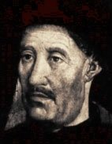
European Colonization
The Portuguese
The Portuguese were the first to begin searching for an all water route to Asia…..
Prince Henry the Navigator – 1450’s
Colonized the South America in the area of what would become Brazil

Slide 27
Explorers Sailing For Portugal
Prince Henry the Navigator - Portugal - Funded Exploration down coast of Africa - 1419-1460
Dias - Portugal - Rounded the Cape of Good Hope - 1488
da Gama - Portugal - Opened trade with India - Placed Portugal in position to dominate trade with India - 1498
Cabral - Portugal - Claimed present day Brazil for Portugal - 1500

Slide 29
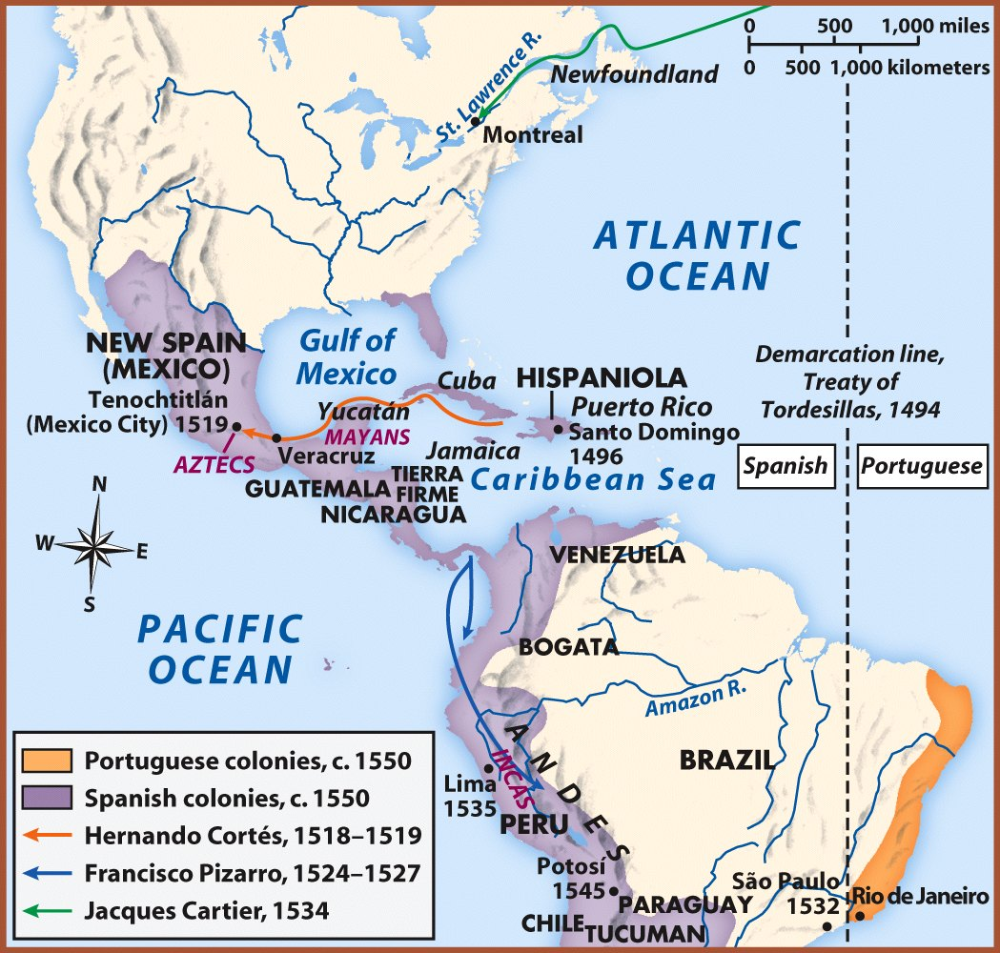
The Treaty of Tordesillas, 1434 & The Pope’s Line of Demarcation, 1493
Spanish-born Pope Alexander VI gave Spain a head-start in the quest for domination over newly discovered regions of the world.
The Pope decreed that all lands discovered west of his line should belong to Spain while new lands discovered east of that line would belong to Portugal.
Portugal was angry, so King John II negotiated with King Ferdinand and Queen Isabella of Spain to move the line to the west.
King John's rationale to Ferdinand and Isabella was that the Pope's line extends all around the globe, thus limiting Spanish influence in Asia.
On June 7, 1494 Spain and Portugal signed a treaty moved the line. This new line (located at approximately 46° 37') gave Portugal more claim to South America yet also provided Portugal with automatic control over most of the Indian Ocean.

Slide 30
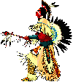
CULTURAL CLASHES
WHITE EUROPEANS
Used the land for economic needs
Clearing the land, destroying hunting areas and fencing it off into private property
Divided the land and selling it for monetary value.
NATIVE AMERICANS
Relationship with environment as part of their religion
Need to hunt for survival
Ownership meant access to the things the land produced, not ownership of the land itself.
VS

