Slide 1
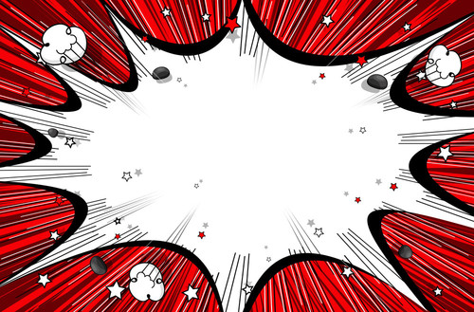
Connotation vs. Denotation
“The subtle meaning of words”

Slide 2
PAUSE AND THINK:
Can words have meaning beyond their literal, dictionary Defined meaning?

Slide 3
Yes, there is more. In fact, every word has at least two definitions:
connotative and denotative

Slide 4
what’s the difference?

Slide 5
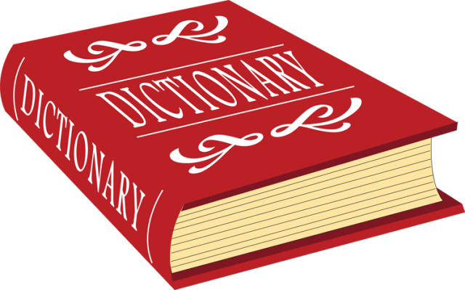
Denotation
The denotation is the literal or dictionary Definition of a word.

Slide 6
Connotation
The Connotation is the Figurative or Emotional Meaning of a word.

Slide 7
Word Choice: https://www.flocabulary.com/unit/word-choice/video/

Slide 8
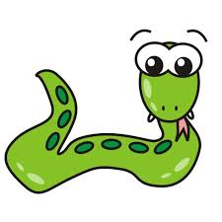
Example- Snake
Denotation:
an animal that has a long, thin body and no arms or legs
Connotation:
Evil, Danger, sin, Deceit

Slide 9
Example- Heart
Denotation:
the organ in your chest that pumps blood through your veins and arteries
Connotation:
Love, Happiness, Passion

Slide 10
Connotations Can Be positive or Negative:
Positive (+)
Negative (-)
Inexpensive vs. Cheap
Curious Vs. Nosey
Youthful vs. Immature

Slide 11
You Try: Which one has a More positive connotation?
Cluttered
OR
Messy

Slide 12
You Try: Which one has a More positive connotation?
Cluttered
OR
Messy

Slide 13
You Try: Which one has a More Negative connotation?
Skinny
OR
Slim

Slide 14
You Try: Which one has a More Negative connotation?
Skinny
OR
Slim

Slide 15
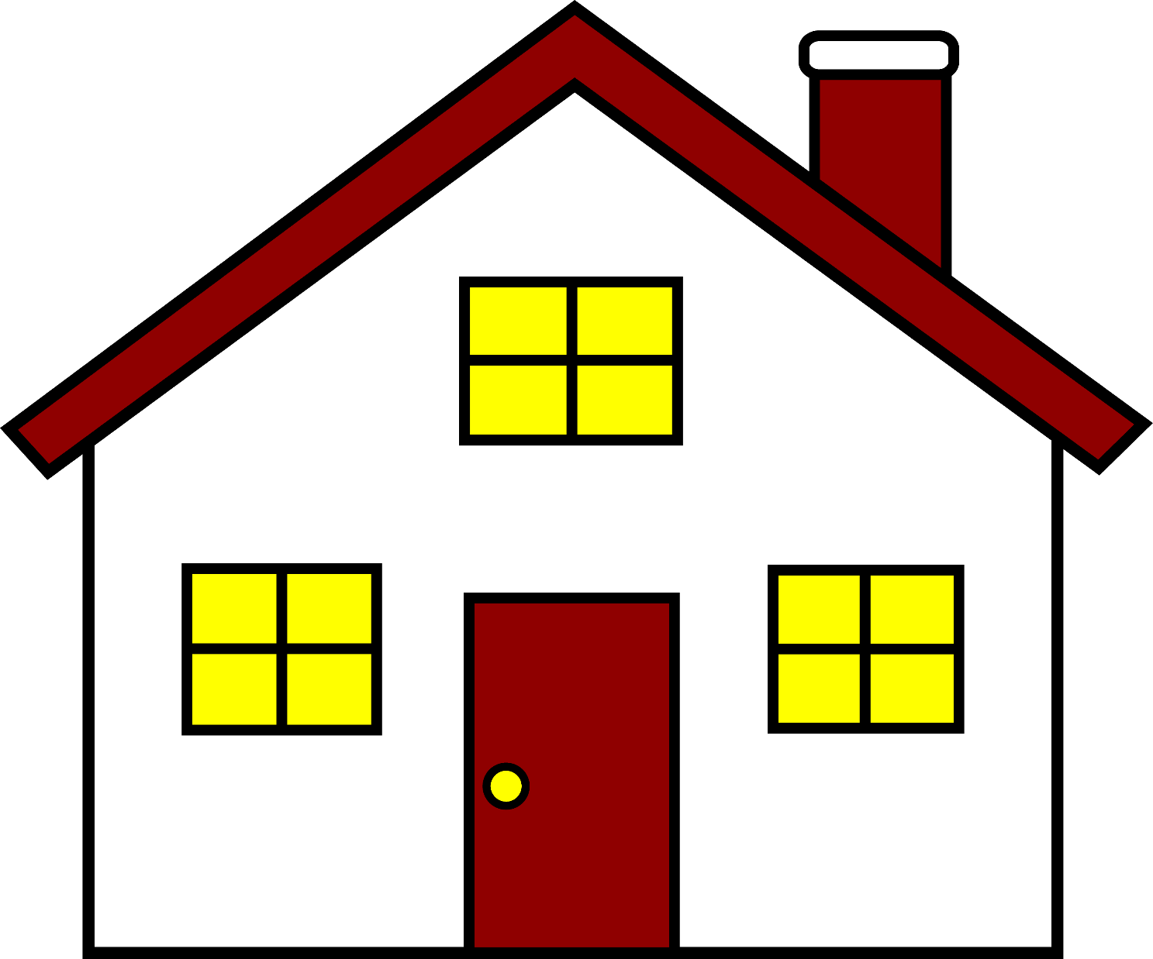
What words could you use to describe this image? What is the connotation of those words?

Slide 16
What words could you use to describe this image? What is the connotation of those words?
Home
cozy, loving, comfortable, security, family
House
the building or structure that people live in
Dwelling
primitive or basic (picture a cave, etc.)
Residence
Cold, no feeling
Denotation: These words all mean a place in which someone lives.

