Slide 1
Greek and Latin Roots

Slide 2
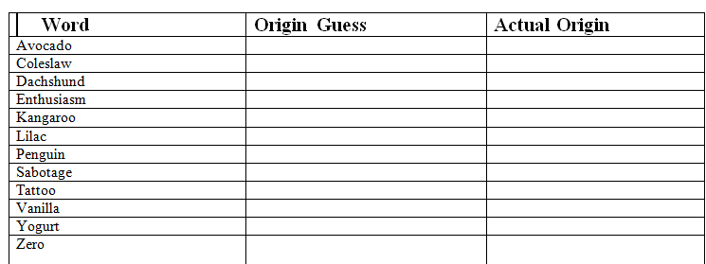
Where did they come from?
Directions: Using the list of English words provided below, identify what language they originated from. Write the correct words in each column of the table.

Slide 3
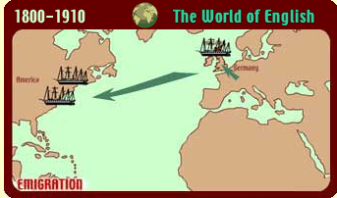
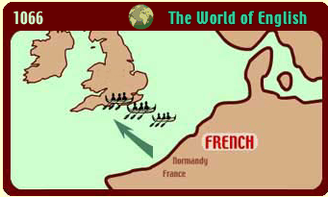
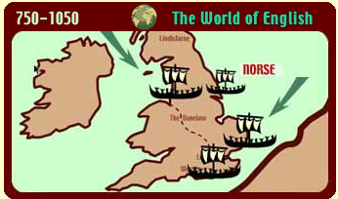
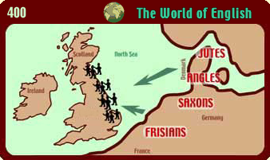
Routes of English
www.bbc.co.uk/radio4/routesofenglish

Slide 4
The Formation of English
Latin was spoken by Romans
Romans conquered most of Europe
Latin spoken in different areas of Europe developed into Italian, French, Spanish, Portuguese.
These languages are called “Sister Languages” because they all developed from the same language, Latin.

Slide 5
Word Invasion
In 1066, William the Conqueror invaded England, and he spoke French, a language derived from Latin.
Now approximately 60% of English words are borrowed from French
Monks from Rome also brought Latin terms.
During the 17th & 18th centuries, English was seen as imperfect and Latin was seen as perfect so to use Latin words in place of English was seen as a good practice

Slide 6
Professional Vocabulary
Latin is used by doctors, attorneys, religious leaders, and other professions.
The Catholic church conducted all masses entirely in Latin until 1969.
Many Latin drama/comedy authors adopted plots, characters, and other ideas from the Greeks.
Latin was used frequently to write scientific and philosophical texts until the late 1800's because of its grammatical flexibility.

Slide 7
Examples
“scapul stat” =immediately”
“Et cetera” or etc. =and otherwise
“&”= and
“pro bono” =for the good
“Canus” (Canine) =dog

Slide 8
Parts of a Word
We know that words are broken into parts that help us figure out their meaning:
Root- contains the core meaning of the word.
Prefix- placed at the beginning of a word to change its meaning.
Suffix- placed at the end of a word to change its meaning.

Slide 9
Affixes
Prefixes:
un- undo
re- refill
pro- for,
forward
Prefixes are at the beginning of words.
pre- means before
fix means attach, repair
Suffixes:
-ful joyful
-ly sadly
-ness kindness
Suffixes are at the end of words.
So, “prefix” means “attached before.”

Slide 10
A root is a set of letters that have meaning. It is the most basic form. Affixes are added to the root to create a new word.
Roots
Example:
The Latin root ject means “throw”
So project can mean “to throw forward”
A root can be at the front, middle or end of a word.
Many words in the English language are based on Greek & Latin word roots.

Slide 11
English words can have all three parts:
prefix + root + suffix
ab + duct + ed
away from + to lead/pull + verb: past tense
abducted means ”pulled or lead away from”
i.e. The general was abducted by masked gunmen.
Word | Meaning
geology | earth study / study of the earth
telegraph | distance writing / writing that travels far
tricycle | three wheels
asocial | not being companionable / not wanting to join others

Slide 12
Importance
Knowing and using Greek and Latin word roots can help you figure out the meaning of words you don’t recognize.
This will make you a better reader and writer.

Slide 13
Nike
She was the winged goddess of victory--victory both in war and in peaceful competition
!
!

Slide 14
A/An-
!
!
Nike
Meaning: not, without
Examples:
Abyss- without a bottom
Achromatic- without color

Slide 15
Anti-
!
!
Nike
Meaning: against
Examples:
antibody - a substance that destroys micro-organisms
antisocial - opposing social norm

Slide 16
Bi-
!
!
Nike
Meaning: two
Examples:
bicycle- a vehicle on two wheels propelled by peddles
biannual - happening twice a year

Slide 17
Bio-
!
!
Nike
Meaning: life
Examples:
biology- a natural science concerned with the study of life and living organisms
biography- a life story written by another person

Slide 18
Cent(i)-
!
!
Nike
Meaning: one hundred
Examples:
centimeter - 1/100 of a meter
century - 100 years

Slide 19
-less
!
!
Nike
Meaning: without
Examples:
worthless- without value
meaningless- having no meaning or significance

Slide 20
Post-
!
!
Nike
Meaning: after
Examples:
posthumous - after someone's death
postpone - to delay something

Slide 21
Pre-
!
!
Nike
Meaning: before
Examples:
preamble - a part in front of a formal document prediction - a statement foretelling the future

Slide 22
Sub-
!
!
Nike
Meaning: under
Examples:
submerge - to put underwater
substandard - inferior to accepted standards.

Slide 23
Un-
!
!
Nike
Meaning: not
Examples:
unabridged - not shortened
unfair - opposite of fair

Slide 24
Poseidon
Poseidon is the god of the sea and protector of all aquatic features

Slide 25
Aqua-
!
!
Poseidon
Meaning: water
Examples:
aquarium - a water container for fish
aquatic- relating to water

Slide 26
Bene-
!
!
Poseidon
Meaning: good
Examples:
beneficial - producing a good effect
benevolent - showing kindness or goodwill

Slide 27
dis
!
!
Poseidon
Meaning: apart, away
Examples:
disappear - to move out of sight
dissect - to cut apart piece by piece.

Slide 28
Mal-
!
!
Poseidon
Meaning: bad
Examples:
malicious- showing strong ill will
malcontent – a person who is rebellious; troublemaker

Slide 29
Mis-
!
!
Poseidon
Meaning: wrong
Examples:
mistake- an error
misbehave - to behave badly

Slide 30
-ness
!
!
Poseidon
Meaning: a state of
Examples:
restlessness- a state of being restless
happiness- a state of being happy

Slide 31
-or
!
!
Poseidon
Meaning: a person who
Examples:
advisor- a person who advises others
abductor- a person who kidnaps somone

Slide 32
Re-
!
!
Poseidon
Meaning: again
Examples:
rebound -to spring back again
rewind - to wind something backward

Slide 33
Spec-
!
!
Poseidon
Meaning: to see or look
Examples:
retrospective - a looking back at past things spectator - a person who sees an event
spectacles- glasses

Slide 34
Athena
Athena is the goddess of wisdom, reason, arts and literature.

Slide 35
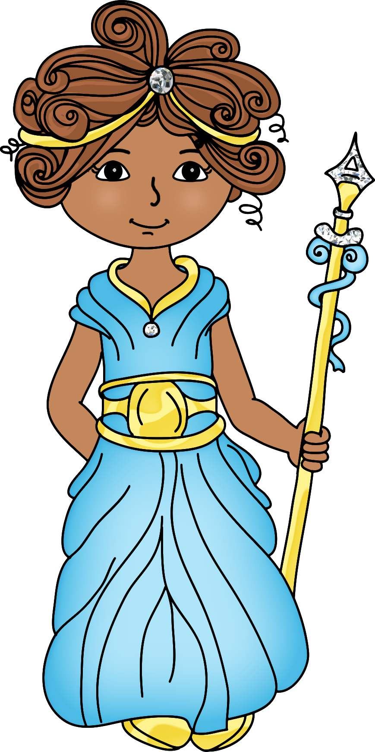
-able or -ible
Athena
Meaning: can be done
Examples:
Comfortable- to be in comfort
Reusable- can be used again

Slide 36
Audi-
Athena
Meaning: hear
Examples:
Audible- can be heard
Audio- sound

Slide 37
Art-
Athena
Meaning: skill
Examples:
artifact - object made by a person's skill
artisan - a person skilled in a craft
artist - a person who creates skillfully

Slide 38
Bibli(o)-
Athena
Meaning: book
Examples:
bibliography - a list of books used as sources; bibliophile - a person who loves books

Slide 39
In-
Athena
Meaning: not
Examples:
inappropriate - not appropriate
Indescribable- not able to be described

Slide 40
Multi-
Athena
Meaning: many
Examples:
multicolored - having many colors
multimedia - using a range of media
multitasking - doing many things at once.

Slide 41
Psych(o)-
Athena
Meaning: mind, mental
Examples:
psyche - the human spirit or soul
psychic - relating to the human mind or someone who has supernatural mental abilities
psychology - the study of the mind.

Slide 42
Struct-
Athena
Meaning: build
Examples:
construct - to build
destruction - the act of destroying something that was built
structure - something built; infrastructure - underlying framework of a system.

Slide 43
Voc-
Athena
Meaning: voice, call
Examples:
advocate - to speak in favor of
vocalize - to produce with your voice.

