Slide 1
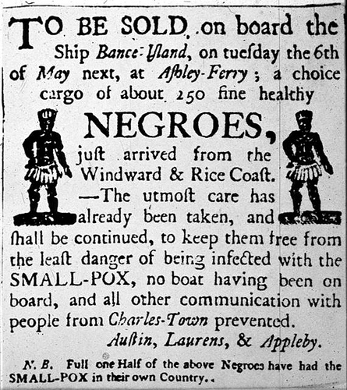
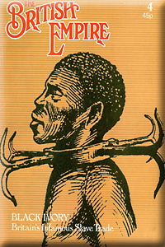
August 17
Analyze and investigate the pictures below. For each picture, describe what you see. What was the original purpose of these images?
What cultural beliefs Europeans use to justify their colonization of peoples throughout the world?

Slide 2
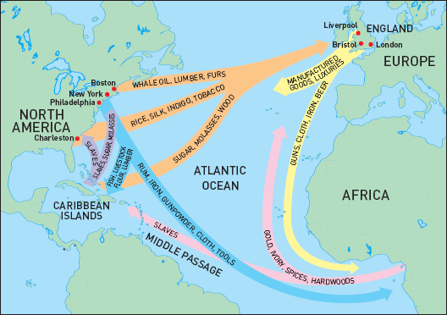
Triangular Trade:
a historical term indicating trade
among three regions, specifically, Africa, Europe and the Americas.
List several of the resources each continent traded with one another.

Slide 3
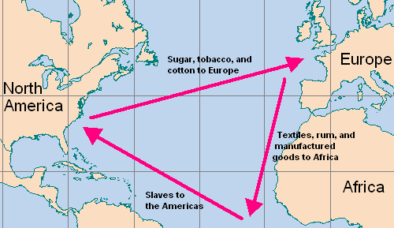

Slide 4
What caused the Triangular Trade?
Natural resources: Resources occurring in nature that can be used to create wealth. Examples include oil, coal, water, and land.
Africa had resources that could be traded with other nations, such as gold & silver, but they were lacking manufactured goods that England and the New World could provide. This created a trading system between the three continents.

Slide 5
What caused the Triangular Trade?
Pretty soon, European countries such as Great Britain, Portugal, France and the Netherlands began establishing permanent colonies in Africa as well as the New World. (which is now America)
This gave Europeans access to natural resources that created great wealth…

Slide 6
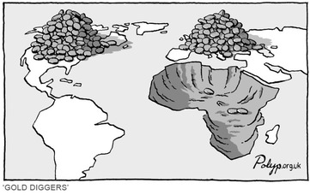
…however, while the European countries were becoming more and more wealthy, Africa was being stripped of resources… human resources.

Slide 7
What caused the Transatlantic Slave Trade?
There was an incredible need for strong laborers to help build and pioneer this New Land.
Also, there was a need for plantation workers so that additional natural resources, such as sugar, molasses and tobacco could be traded with Europe.

Slide 8
The Transatlantic Slave Trade
The need for labor created the beginning of the Transatlantic Slave Trade, where millions of Africans were sold by African tribes or captured into slavery and sold for a massive profit.
Slaves could be bought for $20 and sold in the Americas for up to $120 dollars.
Eventually, the demand for labor was so strong Europeans no longer traded manufactured goods for slaves, but began capturing Africans against the will of the African people.

Slide 9
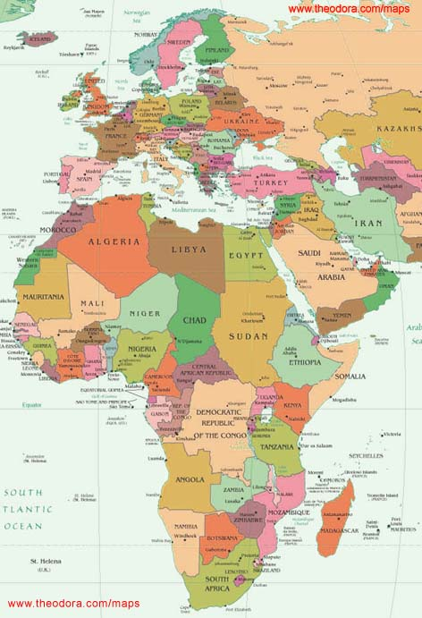
Transatlantic Slave Trade European nations would capture or trade manufactured goods for African people and sell them to “The New World” for profit.

Slide 10
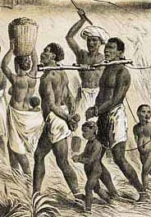
Trans-Atlantic Slave Trade
Surprisingly, slavery was not new to Africa. Various kingdoms would force people into labor.
However, the number of slaves skyrocketed when Europe began exploiting Africa.
Nearly 12 million people were sold into slavery.

Slide 11
Effects of the Transatlantic Slave Trade
10-16 million African people were sold into slavery leaving a significant portion of African without its strongest men
Families were torn apart
European colonies thrived and were extremely wealthy while Africans were exploited and lost great wealth

Slide 12
Effects of the Transatlantic Slave Trade
Probably the most lasting effect is racism.
European nations tried to use science to prove that Africans were in some way “less than human”, or an inferior race to justify their harsh treatment and enslavement of Africans
Even today some racism remains

