Slide 1
Unit #2: Colonization
Part II: The English

Slide 2
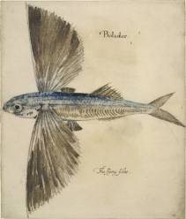
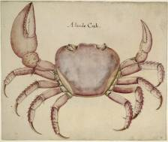
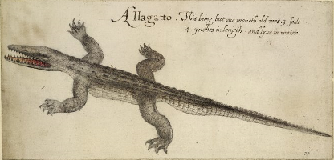
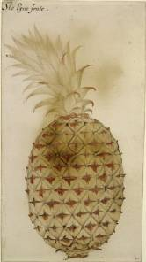
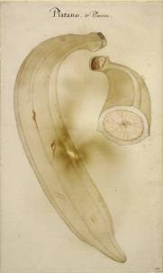
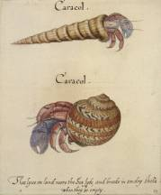
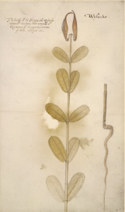
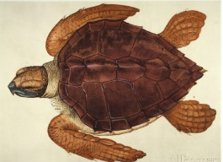
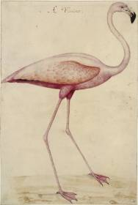
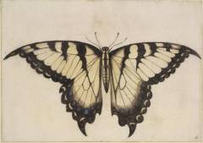
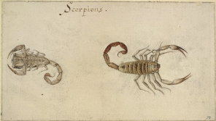
John White’s Watercolors
“Draw to life all strange birds, beasts, fishes, plants, herbs, trees, and fruits and bring home of each sort as near as you may.”
-Instructions given to the artist who traveled on a 1583 voyage to the northern Atlantic coast of America.
Notes:
2

Slide 3
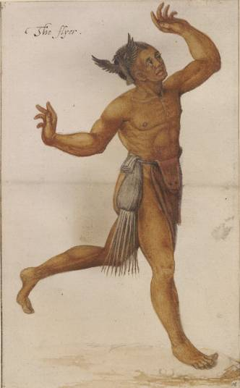
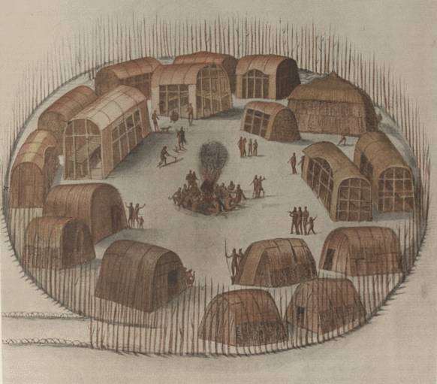
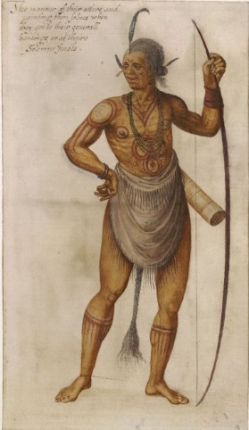
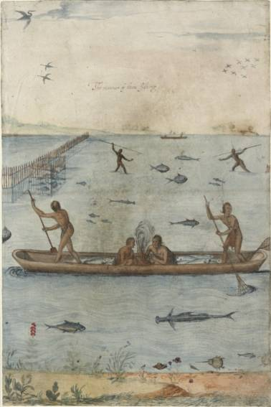
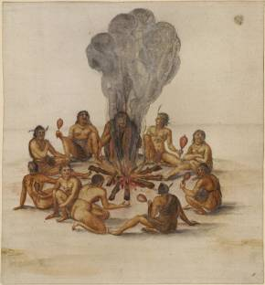
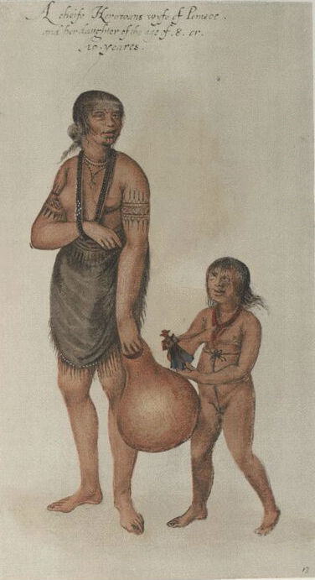
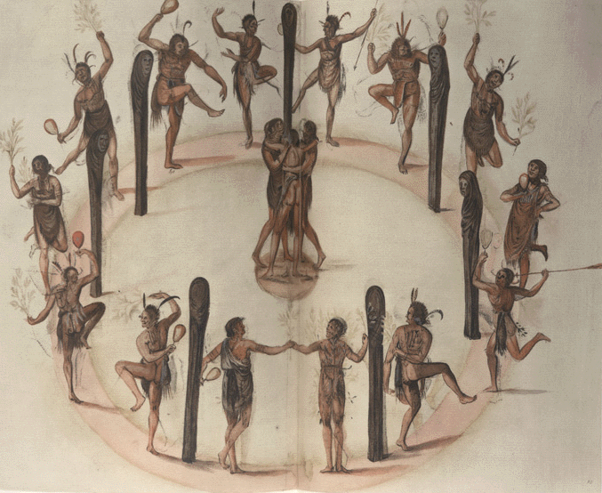
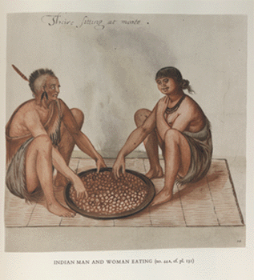
John White’s Watercolors

Slide 4
Painting Analysis
What were common subjects of White’s paintings?
Based on the paintings, what attitude did the colonist have towards the indigenous people?
What impact would these paintings have had on Europeans?
Are paintings considered primary sources? Why what can we learn from them?

Slide 5
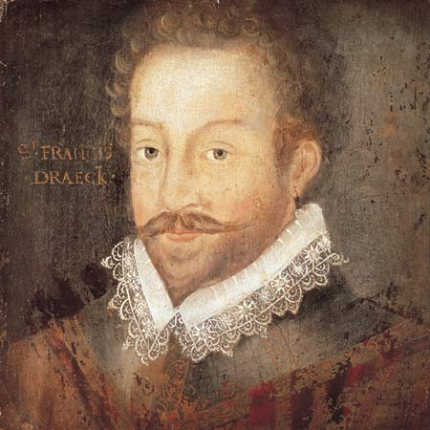
The Defeat of the Spanish
1588 –
Sir Francis
Drake
(England)
lead the defeat of the Spanish Armada

Slide 6
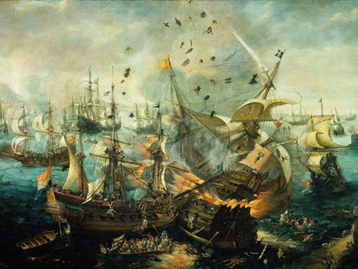
The Defeat of the Spanish
In the late 1580s, English raids against Spanish commerce and Queen Elizabeth I’s support of the Dutch rebels in the Spanish Netherlands led King Philip II of Spain to plan the conquest of England.
Supported by Pope who hoped to bring England back to Catholicism.
Goal: Secure control of the English Channel and begin invasion of England
Spain’s large force of 130 ships carrying 2,500 guns, 8,000 seamen, and almost 20,000 soldiers faced may setbacks
Raids by Sir Francis Drake slowed them down
Storms pushed them back and caused many to wreak along the coast of Scotland and Ireland
Lack of supplies
The English forced them to retreat using fire ships
Only half of Spain’s original fleet made it back to Spain
England became a dominate world power

Slide 7
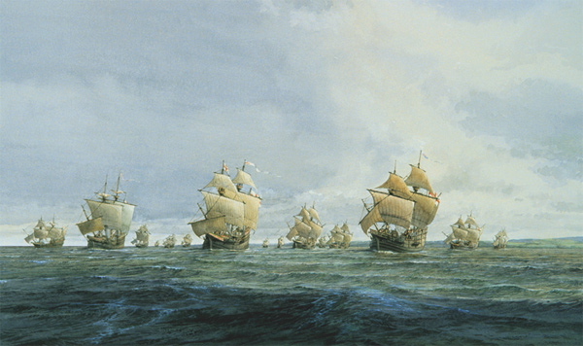
IMPORTANT!!!
Why is the defeat of the Spanish Armada so important?
Opens seas for ENGLAND
to explore and colonize America!!!

Slide 8
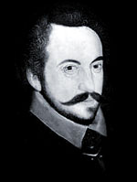
Sir Humphrey Gilbert
Claimed Newfoundland for Queen Elizabeth (England)

Slide 9
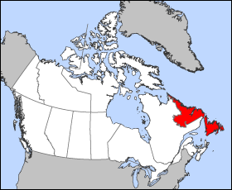
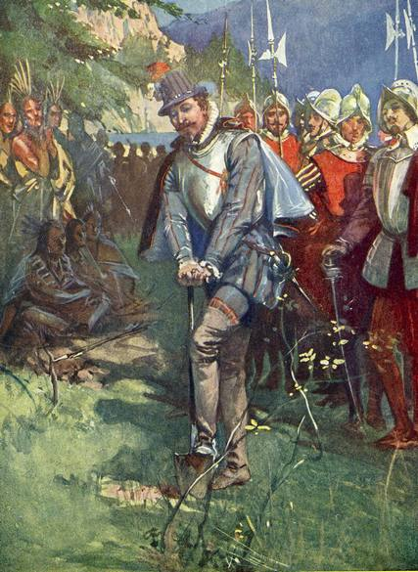
Sir Humphrey Gilbert cutting the first sod in Newfoundland in August 1583. Sir Humphrey Gilbert's British colony on Newfoundland failed partially because the colonists were more anxious to find silver mines than to plant crops.

Slide 10
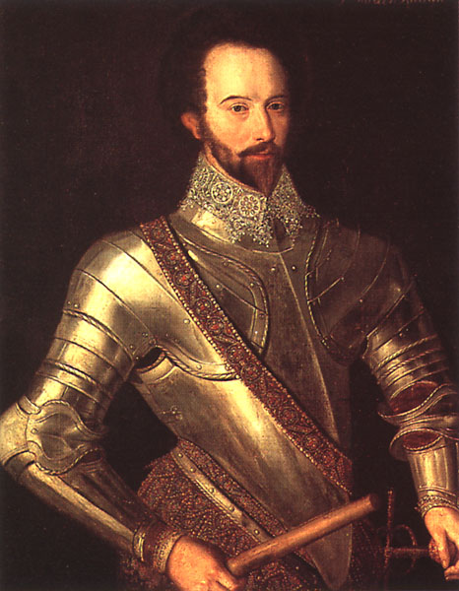
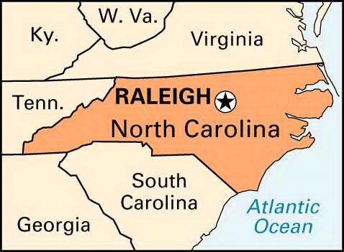
Sir Walter Raleigh –
Explored and reported positives
of settling
Roanoke Island
(off coast of
North Carolina)
The capitol of North Carolina is now named after Sir Walter Raleigh

Slide 11
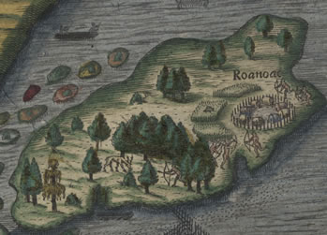
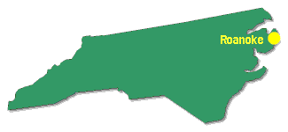
The 1st Attempt at Roanoke
Roanoke – 1585 The 1st attempt at an English colony in America. After a harsh winter the settlement was vacated.

Slide 12
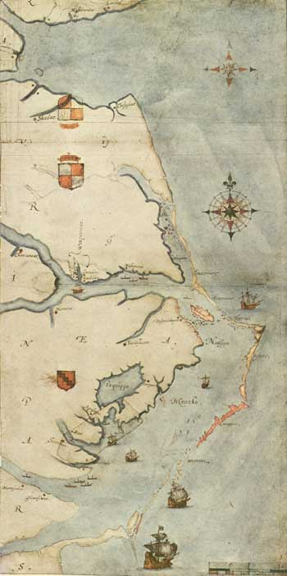
The Lost Colony
John White –
Tried again two years later. After settling, White goes back to England for supplies and ….
This is a 1585 map drawn by John White of the North Carolina area where Roanoke was settled.

Slide 13
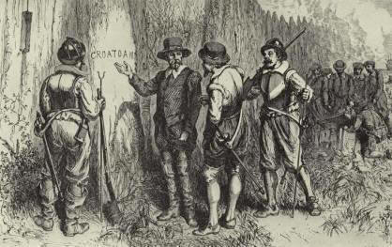
Upon his return (3 years later after war with Spain)
he found only the word
CROATOAN
and nothing else !!!
Read more about the mysterious
disappearance of
“The Lost Colony” tonight for homework

Slide 14
The Joint Stock Company
After many failed attempts at settling the new world, England changed business practices and created what was known as the joint-stock company -a collection of investors who pool their money for large business ventures. The goal of a joint stock company is to make a profit.
+
= Colony

Slide 15
The Virginia Company - Received a charter to settle in the area known as Virginia. A charter was permission from the king to start a settlement. This settlement was called Jamestown.

Slide 16
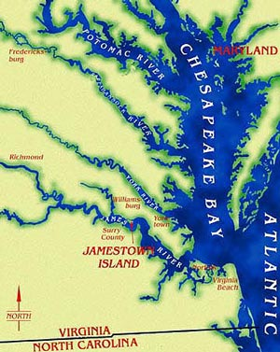
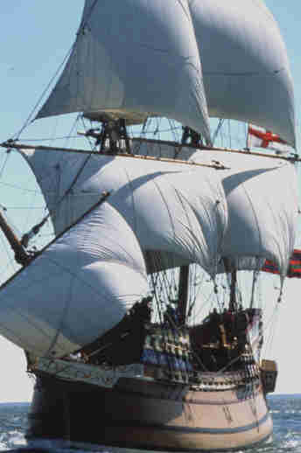
Jamestown was settled inside of the Chesapeake Bay in Virginia near present day Williamsburg, Virginia.

Slide 17
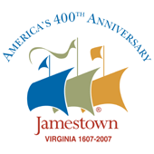
GOVERNMENT
1608 - Capitan John Smith instilled military rule forcing colonists to work and made peace with the local Powhatan Tribe. Colony had success.
1609 - Lord De La Warr continued it. He was a strict, poor leader (later founded of Delaware)
1619 - Sir George Yeardly started a House of Burgesses because the men wanted a say in the government.
After about 12 years the colony started to succeed.

Slide 18
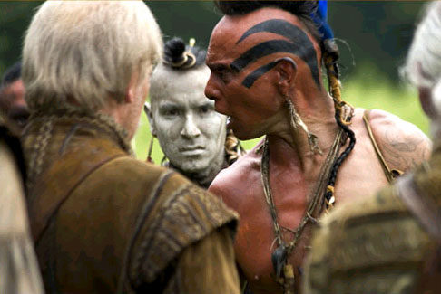
OBSTACLES
NATIVE AMERICANS – Violence came when the English settled the good land
What challenges did the colonists face?
WEATHER –
Harsh winters forced colonists to feed from animals they didn’t want to lose

Slide 19
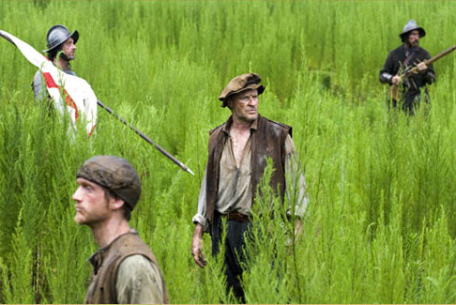
OBSTACLES
DISEASE – Malnourishment, new climate (swamp) and close quarters increased sickness
GOVERNMENT –
Early lack of leadership allowed settlers to search for gold instead of growing crops

Slide 20
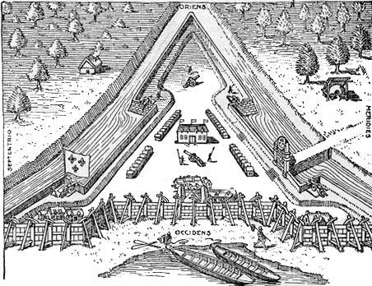
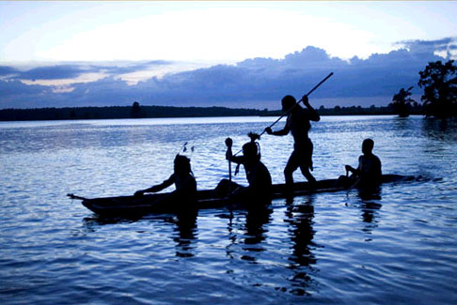
What helped Jamestown SURVIVE?
THE COLONY’S STRUCTURE: fort-like to keep Native Americans out.
NATIVE AMERICANS: The Powhatan Tribe helped them gain the food they needed to survive.

Slide 21
What helped Jamestown survive?
TOBACCO: John Rolfe learned to grow a less bitter kind, giving them a profitable crop. It was sold back in England.

Slide 22
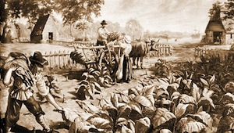
What Helped Jamestown Survive?
To entice new settlers to come to Virginia the head of the Virginia company developed the headright system.
The headright system allowed a land owner 50 acres of land extra for every person brought to America.
This led to indentured servitude where a person sold themselves into servitude for five to seven years for passage to the new world

Slide 23
What helped Jamestown survive?
REINFORCEMENTS : Many more came to settle, including women, which counteracted the high death rate
Population
1,000
866
843
1,277
Year Arrive
1619 - - -
1620 100 (est)
1621 1,051
1624 4,000

Slide 25
The final years of Jamestown…
Africans were brought to Jamestown as laborers, not slaves (but against their will)
In 1624, King James cancelled the charter and took control of the colony.

Slide 26
Plymouth Colony
1620 -
More colonists headed for Virginia but landed in Plymouth instead. They were out of supplies so they decided to stay.

Slide 27
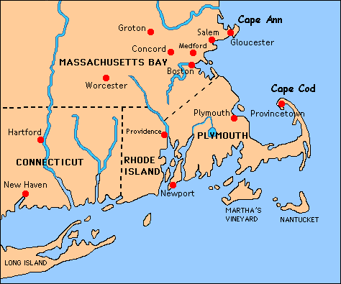
Plymouth Colony
Most believe religious differences led to the Pilgrims establishing the colony of Plymouth.
However, only about 1/3 of them were actually Pilgrims (religious journey) The Pilgrims were Separatists-people who left the English Church.

Slide 28
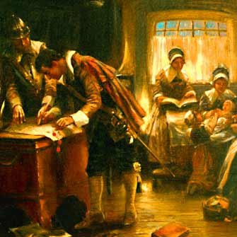
The Mayflower Compact
Created to establish order, all agreed to follow the rules
All had a say in the rules (majority rule)

Slide 29
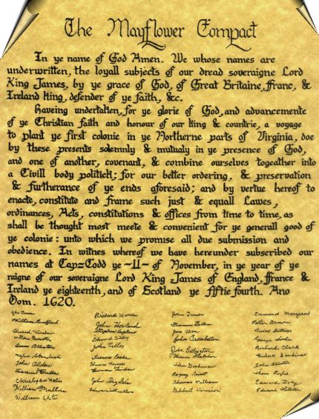
The Mayflower Compact
Used later as a guide for the Constitution (formal plan of Government) in the United States

Slide 30
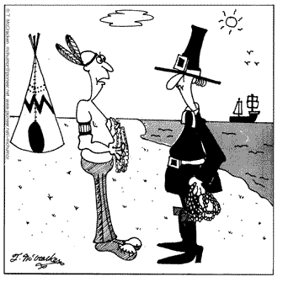
Thanksgiving
Local Indians, Squanto and Samoset helped the colonists farm and hunt.
The colonists invited the Native Americans to feast with them the following fall.

Slide 31
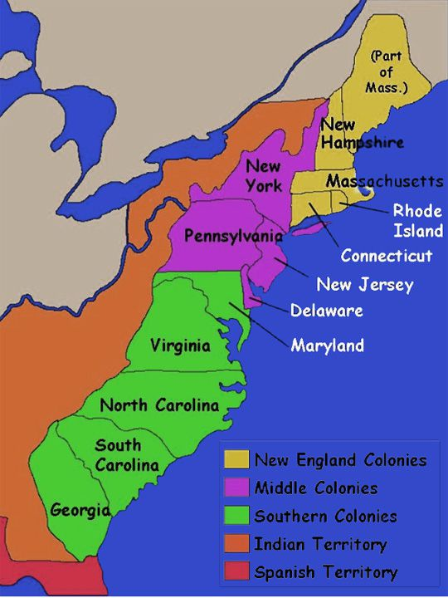
The Thirteen Colonies
Settlers from England continued to settle in the new world mainly for Religious freedom (separatists wanted to leave and form their own church) or for a new start (get out of jail, debt, bad reputation)
The original 13 colonies were formed and England profited off them greatly as a result of trade and taxes

Slide 32
The Thirteen Colonies
New England Colonies- Consisted of mountains, trees, rivers and poor rocky soil that was difficult to farm and unsuitable for crops. Life centered around fishing, the fur trade and commerce.
Middle Colonies- The Middle colonies had fertile soil and land that was suited to farming. Food producing regions included corn and wheat and livestock. Their industries included the production of iron ore, lumber, textiles, furs and shipbuilding
Southern Colonies- The warm climate of the South made it possible to grow crops throughout the year and was ideally suited for Plantations. The plantations produced 'cash crops' of tobacco, cotton, rice and indigo (dye) and this type of agriculture system was based on Slave Plantations.

Slide 33
Recap of the first English Colonies
Roanoke- 1st attempt at an English colony in America. Failure and mystery
Jamestown-1st successful English colony (in Virginia)
Plymouth-2nd successful English colony (in New England)

Slide 34
The French
Didn’t take the land, mostly traded with the Native Americans
Fur trappers
Many French joined life with the Native Americans
Supported by the King of France
Originally didn’t want colonies, but followed the lead of the British
Where: Canada, Mississippi Valley
Important people: Louis Joliet, Jacques Marquette, Robert Cavelier Sieur de La Salle

