Slide 1
Welcome!
Please grab a copy of today’s activity off the table as you come in!
Copy down your homework
Get started on your poster!

Slide 2
The Great Depression in Photographs

Slide 3
The Stock Market crashes on October 1929, which sent Wall Street into a panic and wiped out millions of investors. Banks began to fail and panic spread.
Image #1

Slide 4
People who had gone to bed with thousands of dollars in the bank woke up to discover that they only had the money in their pockets.
Image #2

Slide 5
Consumer spending and investment dropped, causing steep declines in industrial output and rising levels of unemployment as failing companies laid off workers.At the height of the Depression in 1933, nearly 25% of the Nation's total work force, 12,830,000 people, were unemployed.
Image #3

Slide 6
Bread lines, soup kitchens and rising numbers of homeless people became more and more common in America’s towns and cities.
Image #4

Slide 7
Many men traveled around the country seeking work, unfortunately there was nowhere to go.
Image #5

Slide 8
Despite the danger, it was common for men, women, and children to “ride the rails” in search of work. At least 6,500 “hoboes” were killed in one year either in accidents or by railroad "bulls," brutal guards hired by the railroads to make sure the trains carried only paying customers.
Image #6

Slide 9
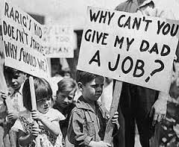
Many families were torn apart. In New York City alone, 20,000 children were placed in institutions because their parents couldn’t support them.
Image #8
Image #7

Slide 10
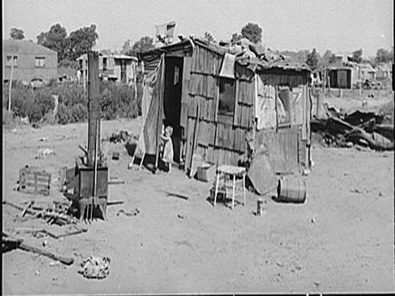
As the Depression worsened and millions of urban and rural families lost their jobs and depleted their savings, they also lost their homes. Desperate for shelter, homeless citizens built shantytowns in and around cities across the nation. These camps came to be called Hoovervilles, after the president.
Image #9
Image #10

Slide 11
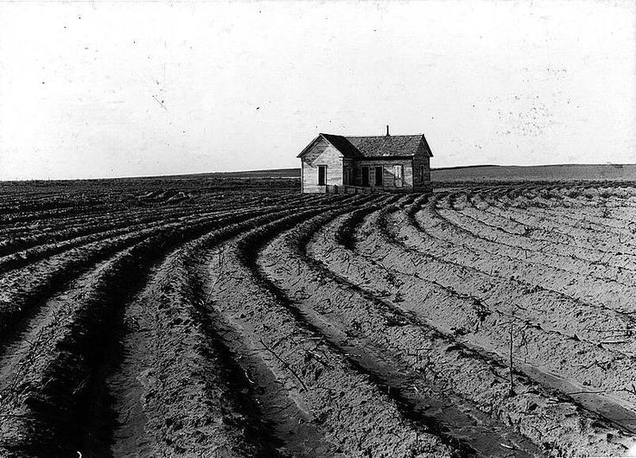
In the early 1930s prices dropped so low, because the demand for crops decreased drastically after the war, that many farmers went bankrupt and lost their farms. In some cases, crops were left to rot in the fields while people around the country starved.
Image #11
Image #12

Slide 12
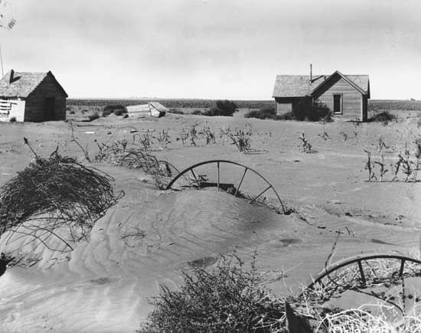
The Dust Bowl was the name given to the Great Plains region devastated by drought in the 1930s. The 150,000-square-mile area has little rainfall, light soil, and high winds, a potentially destructive combination. When drought struck from 1934 to 1937, the soil lacked the stronger root system of grass as an anchor, so the winds easily picked up the loose topsoil and swirled it into dense dust clouds, called “black blizzards.”
Image #13
Image #14

Slide 13
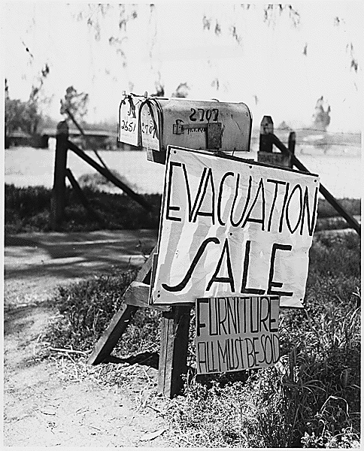
The dust storms wreaked havoc, choking cattle, burying pasture lands, and making the land almost uninhabitable. Thousands of Midwestern family were forced to leave their homes. So many migrated from Oklahoma, they become known as “Okies.”
Image #15
Image #16

Slide 14
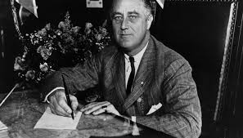
Franklin D Roosevelt is elected president in 1932 after promising to get America’s economy back on its feet.
Image #18
Image #17

Slide 15
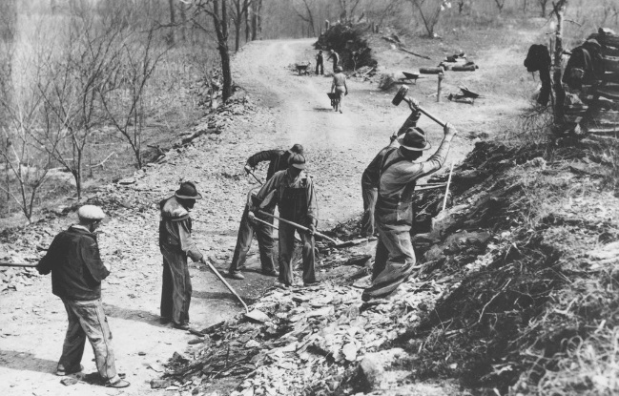
Roosevelt’s New Deal, a series of programs, including Social Security, that were enacted to provide the "3 Rs“: RELIEF for the unemployed and poor, RECOVERY of the economy to normal levels, and REFORM of the financial system to prevent a repeat depression. These reforms created millions of jobs and put Americans back to work.
Image #19
Image #20

